Slide 1
Introduce
Machine Learning
胡文强，孟昊阳， 吕逸飞 | May, 2022

Slide 2

What's machine learning
Part 1

Slide 3

Created by: Jim Liang
:: What’s machine learning ?
What？
what are you talking about ?
A computer programis saidtolearnfrom experienceE
withrespect to someclass oftasksTandperformance
measure Pifits performanceattasksinT, asmeasured
byP,improves withexperienceE.
- Mitchell, T. (1997). Machine Learning, McGraw Hill
The image is designed byAsierromero - Freepik.com

Slide 4
Created by: Jim Liang
:: More friendly definition of Machine Learning
Machine Learning is the science of getting computers to act without being
explicitly programmed.
- Andrew Ng （吴恩达）
Machine learning is a technique of data science that helps computers learn from existing data in order to forecast future behaviors, outcomes, and trends.
- Microsoft

Slide 5

Created by: Jim Liang
:: When should you use Machine Learning ?
1. Do you need machine learning?
2. Can you formulate your problem clearly?
3. Do you have sufficient examples?
4. Does your problem have a regular pattern?
5. Can you find meaningful representations of your data?
6. How do you define success?
Content source: SAP, https://open.sap.com/courses/ml1

Slide 6
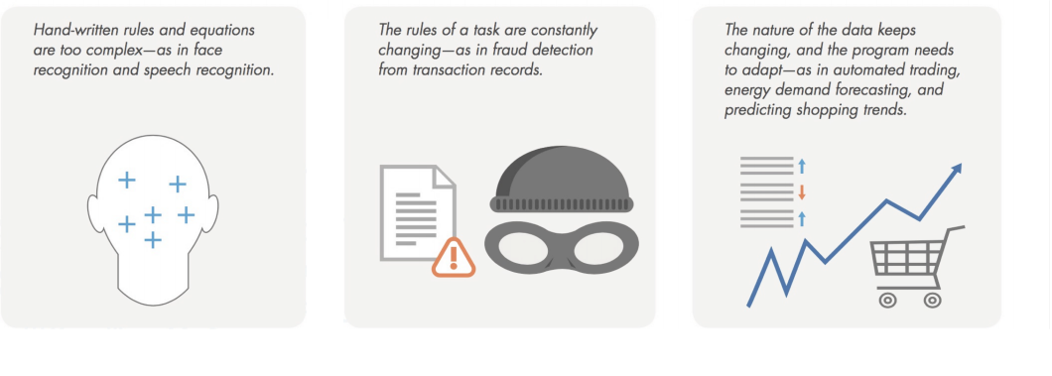
Created by: Jim Liang
Wrap-up: When should you use machine learning ?
Consider using machine learning when you have a complex task or problem involving a large amount of data and lots of variables, but no existing formula or equation. For example, machine learning is a good option if you need to handle situations like these:
Source: Mathworks

Slide 7

Created by: Jim Liang
:: Wrap up
Machines Learning uses historical data to make predictions
Machine Learning is also similar to Data Mining, but whereas data mining is the science of discovering unknown patterns and relationships in data, ML applies previously inferred knowledge to new data to make decisions in real-life applications.
• Computers approximate complex functions from historical data
• Rules are not explicitly programmed but learned from data
Image: https://www.datasciencecentral.com/profiles/blogs/an-introduction-to-machine-learning-theory-and-its-applications-a

Slide 8
The application of machine learning
Part 2

Slide 9
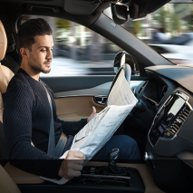
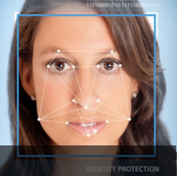
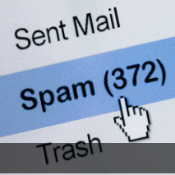

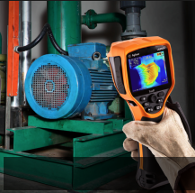
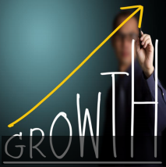

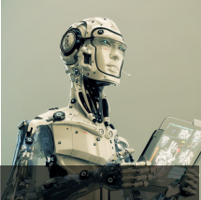
Created by: Jim Liang
:: Machine Learning – all around us
Self-Driving
Face Recognition
Spam Detection
Credit card fraud detection
Predictive Maintenance
Sales Forecast
Voice Recognition
Robot

Slide 10
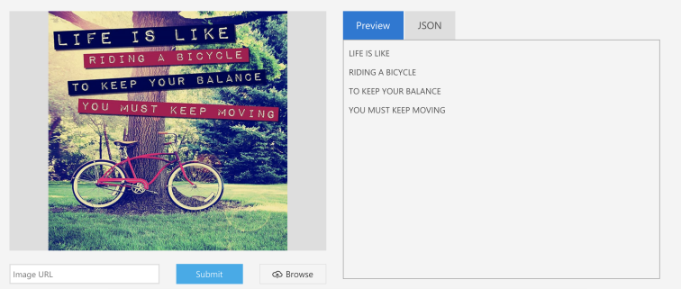
Created by: Jim Liang
:: Computer vision - See it in action
Cool demos from Microsoft
There are couple of demos which show the capabilities of computer vision. For example, Analyze an image, Read text in images, Read handwritten text from images
Read text in images
You can try these demos by yourself. Just upload your image and see what will happen. It’s nice! https://azure.microsoft.com/en-us/services/cognitive-services/computer-vision/

Slide 11
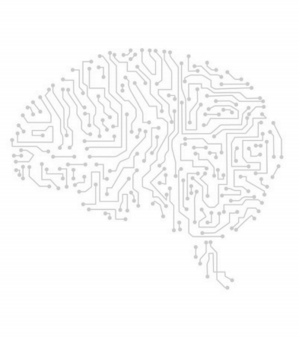
Created by: Jim Liang
:: Machines can now do things that were not possible before
Why now ?
• Big Data
• Massive Computer power (e.g. GPU, multicore)
• Better algorithms
(e.g. Deep Learning algorithms )

Slide 12
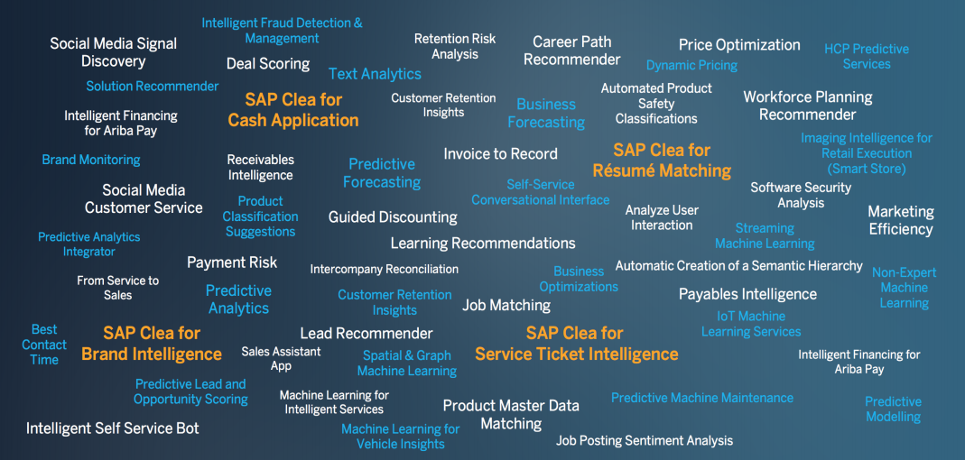
Created by: Jim Liang
:: Big Pool of Machine Learning Use Cases
Image Source: SAP

Slide 13
The fundamentals of machine learning
Part 3

Slide 14


Created by: Jim Liang
:: About AI , Machine Learning and Deep Learning
Field of Artificial Intelligence
Field of Machine Learning
Deep Learning

Slide 15
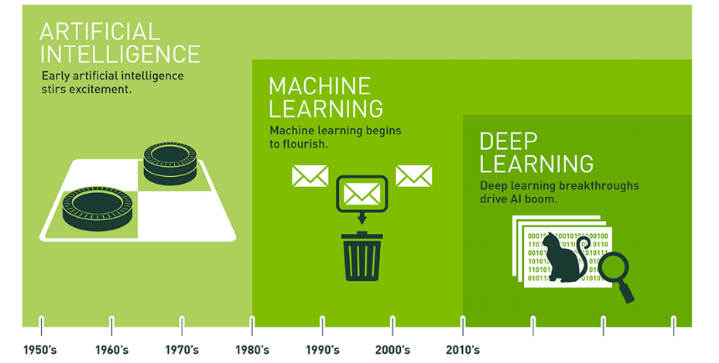
Created by: Jim Liang
:: Artificial Intelligence has been
evolving
Since an early flush optimism in the 1950s, smaller subsets of artificial intelligence – first machine learning, then deep learning, a subset of machine learning – have created ever larger disruptions
Source: https://blogs.nvidia.com/blog/2016/07/29/whats-difference-artificial-intelligence-machine-learning-deep-learning-ai/

Slide 16
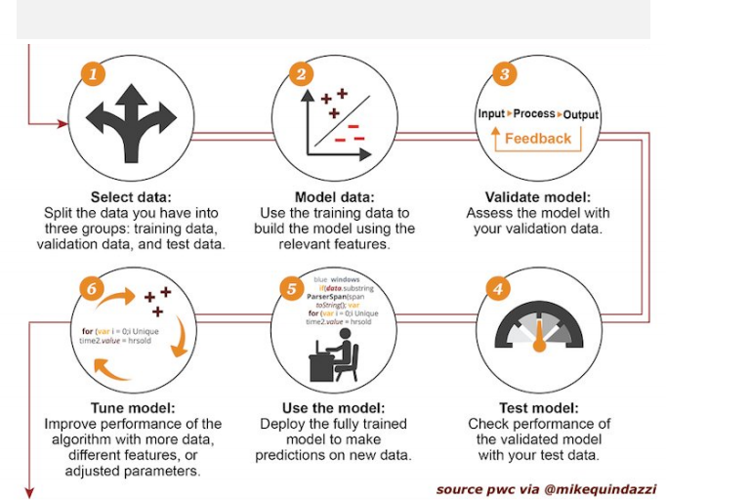


Created by: Jim Liang
:: How machine learning works
How machine learning works
2
Validate Model:
Assess the model with
your validation data.
4
Tune Model:
Improve performance of the
algorithm with more data
different features, or
1
3
Select Data:
Split the data you have into
Model Data:
Use the training data to
three groups: Training data,
build the model using the
validation data , and test data
relevant features.
6
5
Use Model:
Deploy the full trained
Test Model:
Check performance of
model to make
the validated model with
predictions on new data
your test data
adjusted parameters
Image Source: PWC

Slide 17
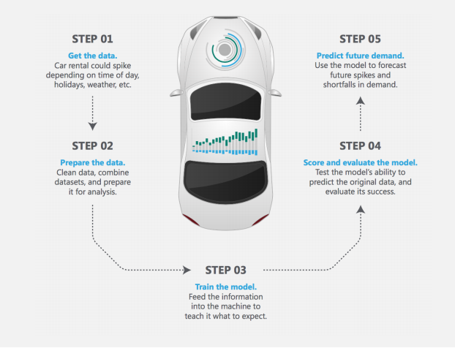
Created by: Jim Liang
:: Example of machine learning task
For that you need Regression Analysis
Let’s say you rent cars
How can you accurately predict demand for your product ?
Source: https://docs.microsoft.com/en-us/azure/machine-learning/machine-learning-basics-infographic-with-algorithm-examples

Slide 18
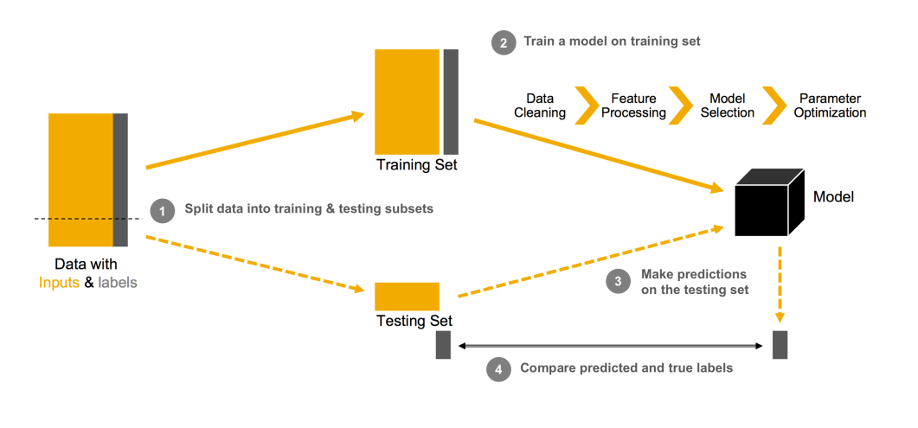


Created by: Jim Liang
:: How to create machine learning models ?
Data Cleansing
Feature Processing
Model Selection
Parameter Optimization
Training Set
Model
Model
Data with Inputs & Labels
Testing Set
Source ：SAP

Slide 19
Thank you !
Table of contents |
➤

